Slide 1
Predicting Cardiovascular
Disease
Jonathan Murthy

Slide 2
Research Question
What model can most accurately predict whether or not a patient will have Cardiovascular disease?

Slide 3
The Data
Source: https://www.kaggle.com/sulianova/cardiovascular-disease-dataset
Features: Age (cont), Gender (cat), Height cm (cont), Weight kg (cont), Blood Pressure (cont), Cholesterol(cat), Glucose (cat), Smoker (cat), Alcohol use (cat), Active (cat)
Target: Cardio (binary)

Slide 4
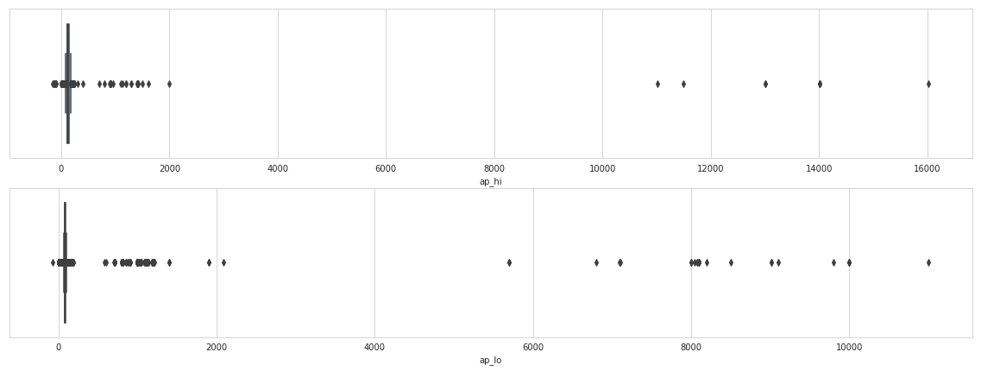
Cleaning the Data
Outliers
Blood Pressure

Slide 5
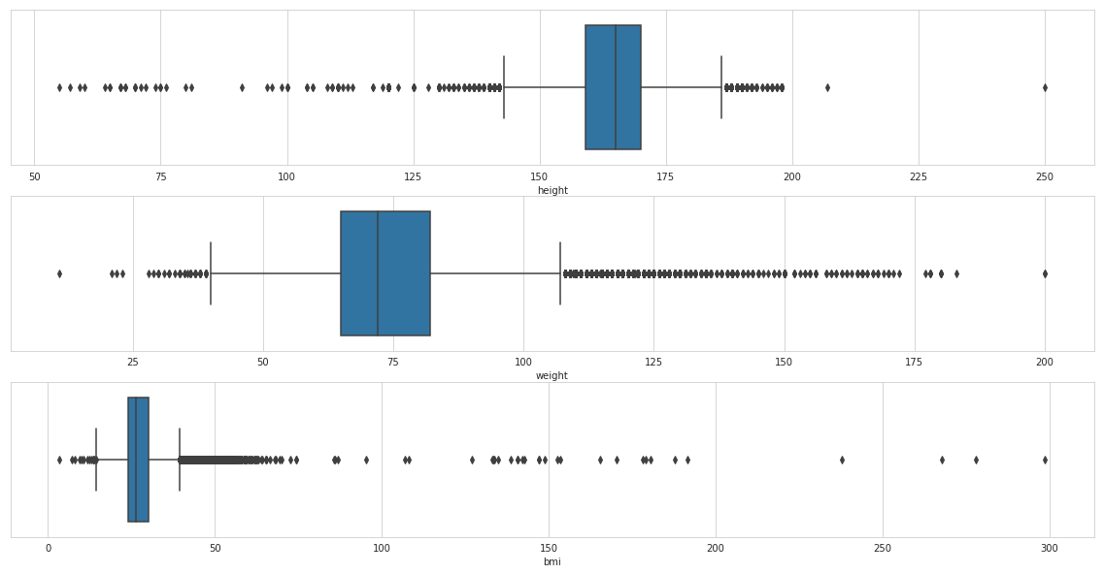
Outliers cont
Weight and Height

Slide 6
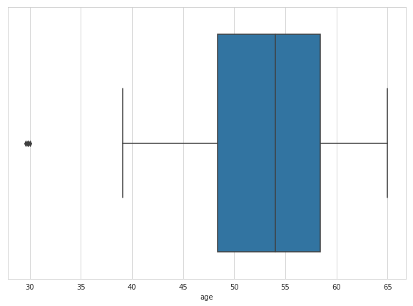
Age

Slide 7
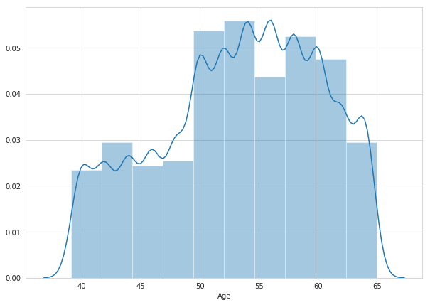
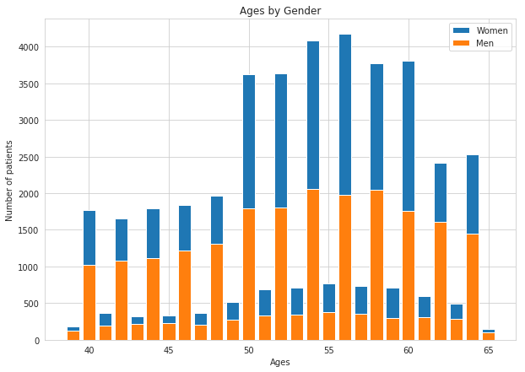
Exploratory Data Analysis

Slide 8
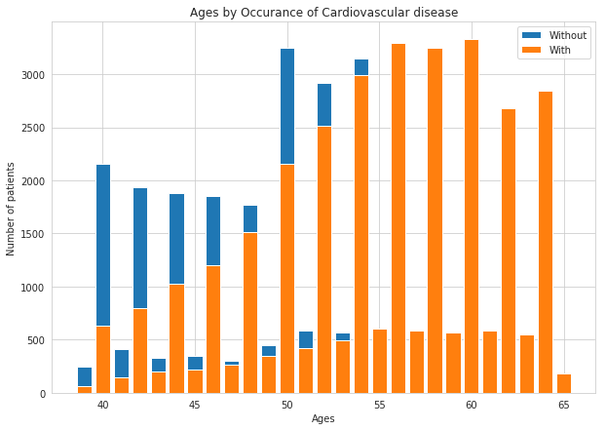

Slide 9
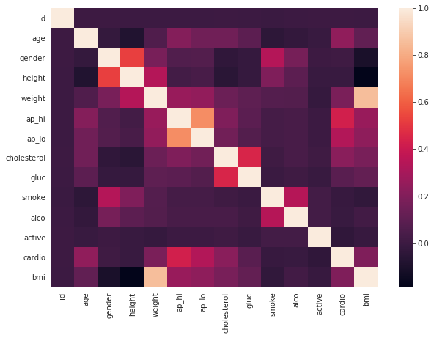
Correlation heatmap

Slide 10
Feature Selection
Relatively small feature set
Different samples
Full Feature Set
SelectKBest
K = 10
PCA
n_components = 10

Slide 11
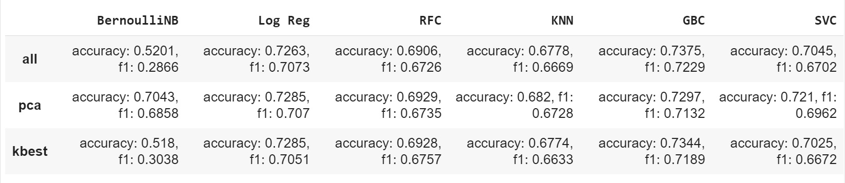
Cleaned Dataset

Slide 12
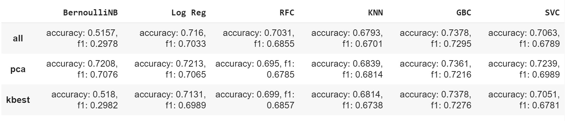
Full Dataset

Slide 13
Conclusion
Overall small difference between the cleaned and full datasets
Gradient Boosting Classifier produced the best scores in both datasets
BernoulliNB performed the worst with the exception of when PCA is used
The score overall does not vary that much between models
SVC took the longest

Slide 14
Practical Use
Predict likelihood of a patient having cardiovascular disease

Slide 15
Shortcomings
There could be more interesting features for predicting cardiovascular disease (e.g. socioeconomic data, time series data, geographical/regional data, education, more lab tests)
Computational limitations. More powerful computation could allow for more observations

